Slide 1



Appu The Search Engine COMP-8547 Advanced Computing Concepts
Arun Sivakumar
Dhamina Sarvathikari
Priya Samanvi Gudi
Mohammed Harris Jinnah Mohideen
Sridhar Gopu

Slide 2

Agenda
Abstract.
Search Engine Architecture.
Web Crawler.
Html to Text Parser.
Reverse Indexing.
Caching.
Auto Correction

Slide 3
About the project
Build a Search engine which crawls thousands of BBC web pages using web crawler, following these pages to discover new pages.
The crawler navigates through the DOM(document object model) data received by the browser on first search and crawls through all the linked websites, downloading the human readable contents to a file which can later be used by the search engine functionalities like reverse indexing and auto complete to present a set of relevant results to the user.

Slide 4


Search engine
Wide expanse of information available on internet
Mechanism that finds the information that is relevant, providing the scope to the search engine

Slide 5
Search engine architecture
WEB CRAWLER
HTML TO TEXT PARSER
REVERSE INDEXING
CACHING
AUTO CORRECTION

Slide 6

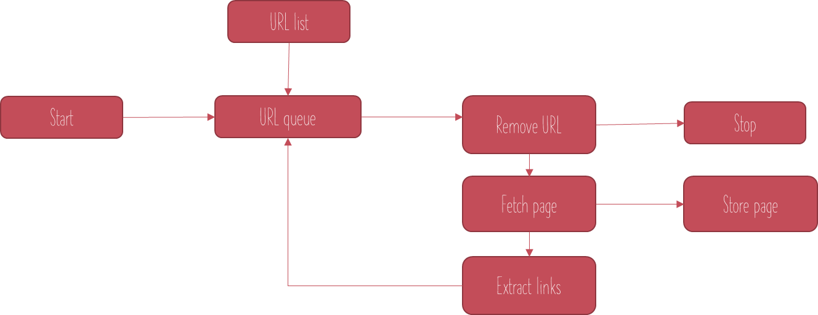
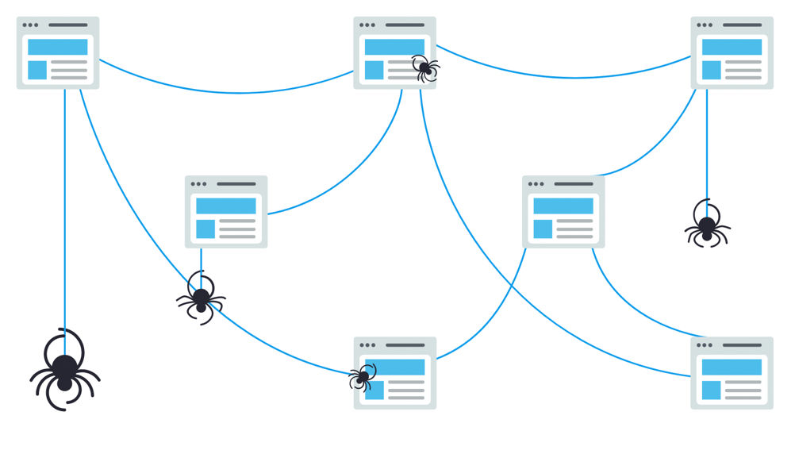
Web crawler

Slide 7
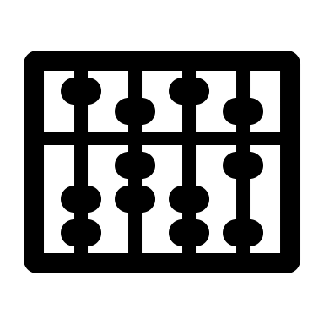

Crawler - algorithm
Step- 1: Initialize the queue (Q) with set of URL’s
Step-2: If Q is empty: stop
else Pop URL from Q
Step-3: If already URL is visited continues loop for next URL
Step- 4: If page P is downloaded: display page
else: exit loop
Step-5: Parse P for new links
Step- 6: Add new links to end of the queue

Slide 8
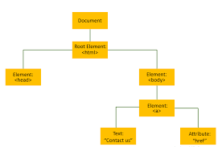
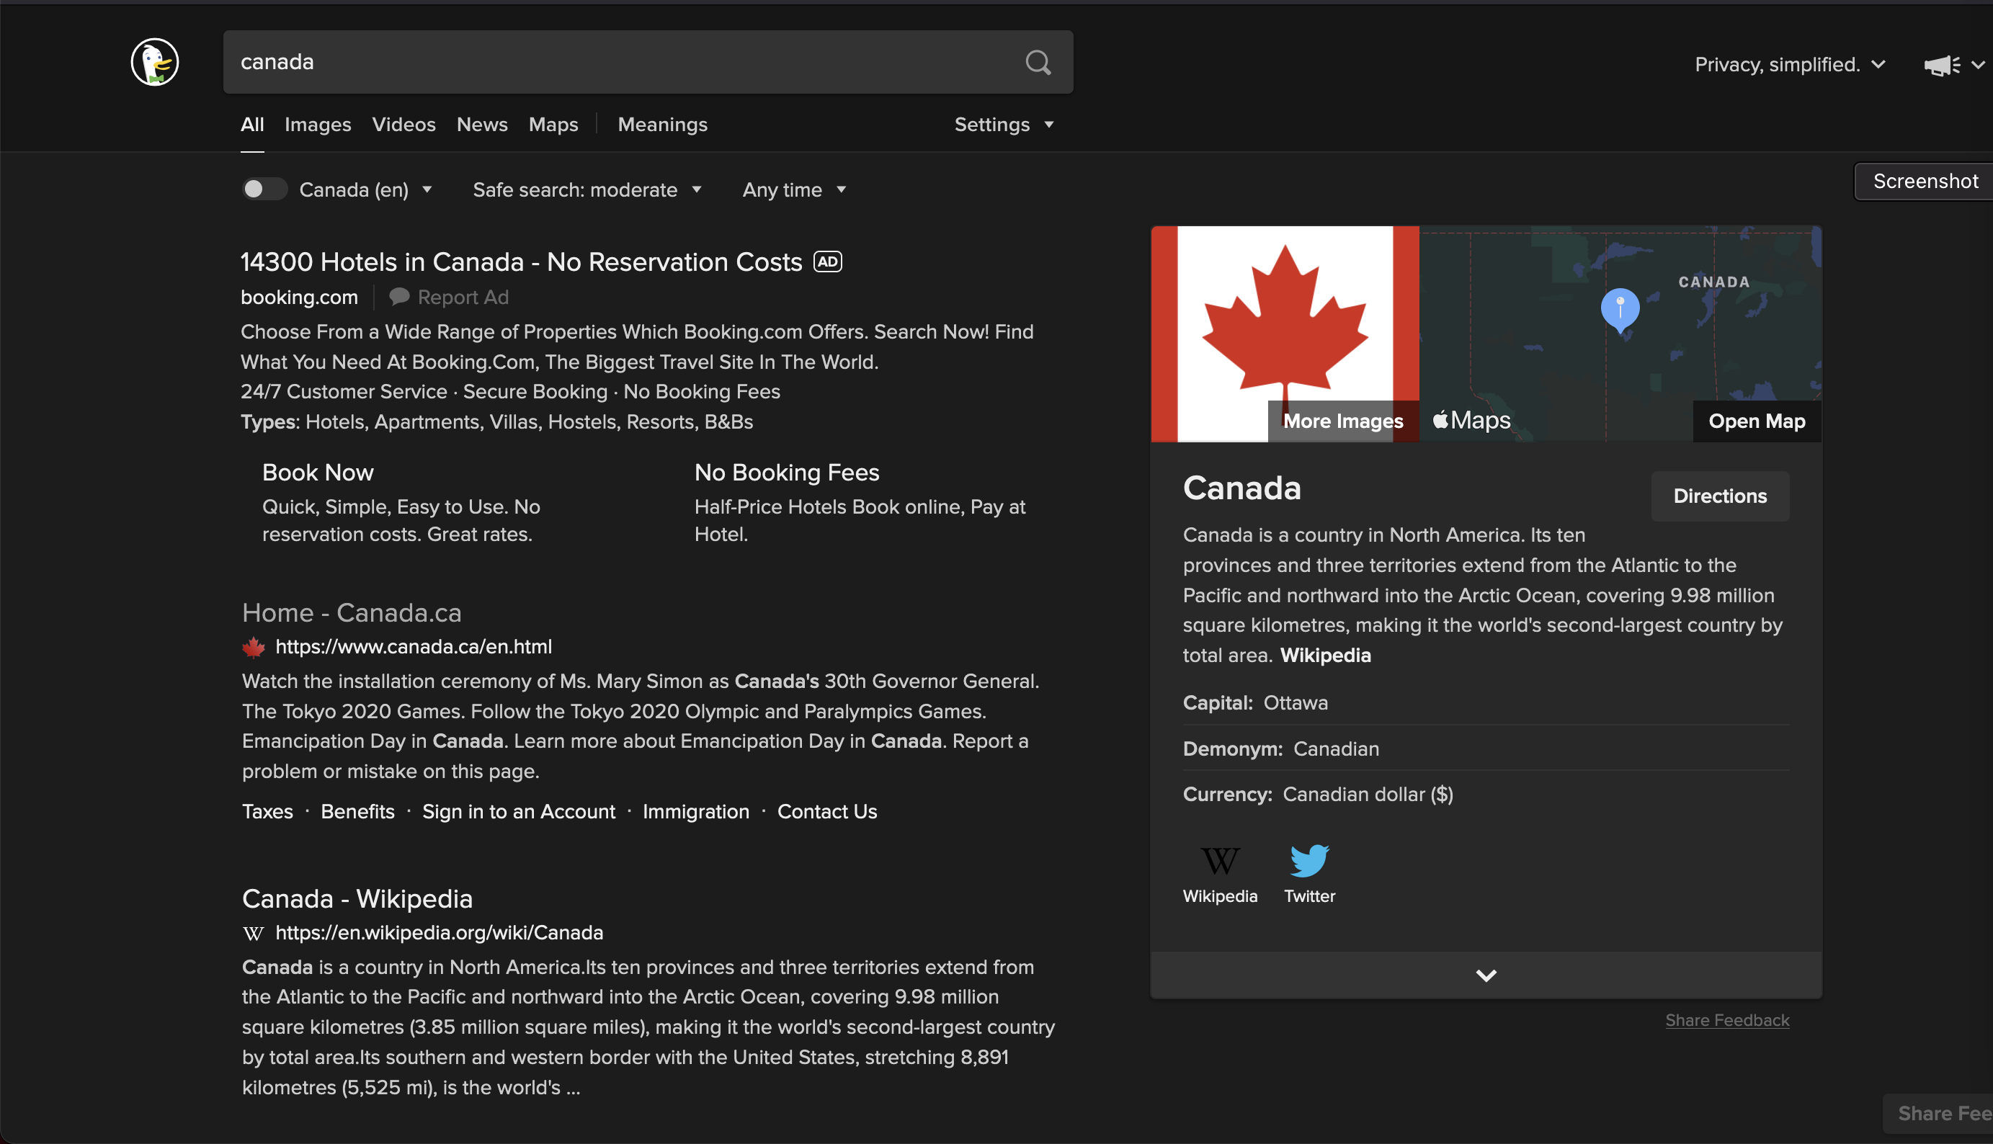
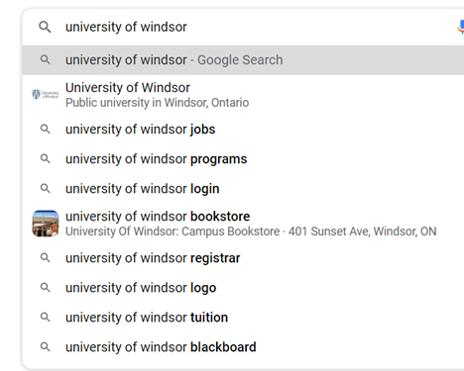
Html to text parser
-Parses HTML page into a Document Object Model(DOM) tree by tokenizing the start and end tags
-Finds paragraph <p>, head<h> and hyperlink<a>
-Parser then parses the tokenized input into document, which builds the document tree

Slide 9

Reverse indexing
- In Reverse indexing , a text elements database is compiled by fetching the documents which contains these elements
- Reduces the number of resources to retrieve and store data
- Faster than documenting all listings against the relevant characters and keywords

Slide 10
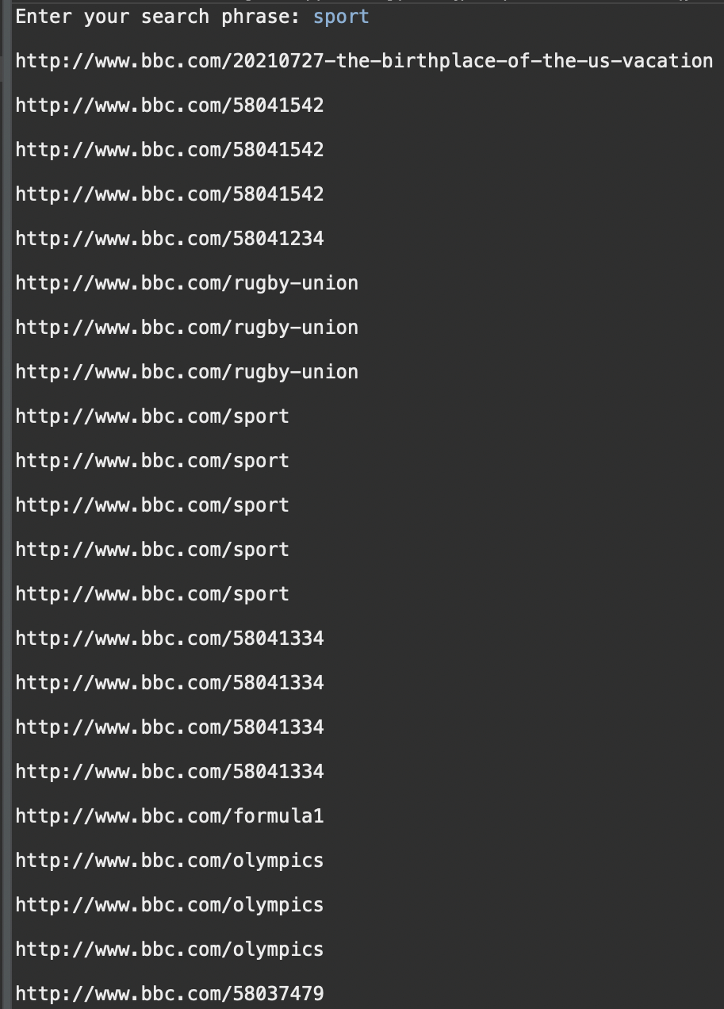
Reverse indexing
Hashmap to store the words and their URLs
Reads the text file and extract words from the text file
It gives the respective list of URLs of the word searched by the user

Slide 11
Tries
A trie (pronounced “try”) is a tree-based data structure for storing strings in
order to support fast pattern matching. The main application for tries is in information
Retrieval
String searching algorithms preprocess the text, rather than the pattern

Slide 12

Auto coRRECTION
-Edit distance is all about measuring how two strings are similar
-For example, in spelling correction, if user typed an erroneous word, it gives the suggestions that is like the used typed word
-Edit distance between any two strings is minimum number of operations performed in transforming one word to other
- Compare two strings and find the distance between them
-On comparing the edit distance between the user input string and words from dictionary, will return the word which has closest edit distance

Slide 13

caching
-On caching, pages are shown as it is indexed by a crawler, when live versions are not in reach we can use cached version of pages
-Provides fast response to user queries by increasing data retrieval performance

Slide 14

Save a web page content in offline, so that the user can read the contents offline from the cache We call is ”pockets”, where we can simply bookmark the webpage of Add to Cache will save the entire content to a text file and can be deleted later.
Caching use case

Slide 15
DEMONSTRATION

Slide 16
Thank You

